Slide 1
Soil Protection:
The role of Soil Resilience
Stephen Nortcliff

Slide 2


Slide 3
First steps towards a European Soil Protection Strategy
2002 - COM(2002) 179 final
Communication from the Commission to the Council, The European Parliament,..
‘Towards a Thematic Strategy for Soil Protection’.

Slide 4
Soil Functions
Food and Biomass production
Storing, filtering and transformations
Habitat and gene pool
Physical and cultural environment for mankind
Source of raw materials

Slide 5
Goods and services provided by land and soil
Human Health
Atmosphere
Biomass Production
(e.g. food chain)
Culture
Open Water
Soil
Biodiversity
Ground Water
W.E.H. Blum, 2004
5

Slide 6
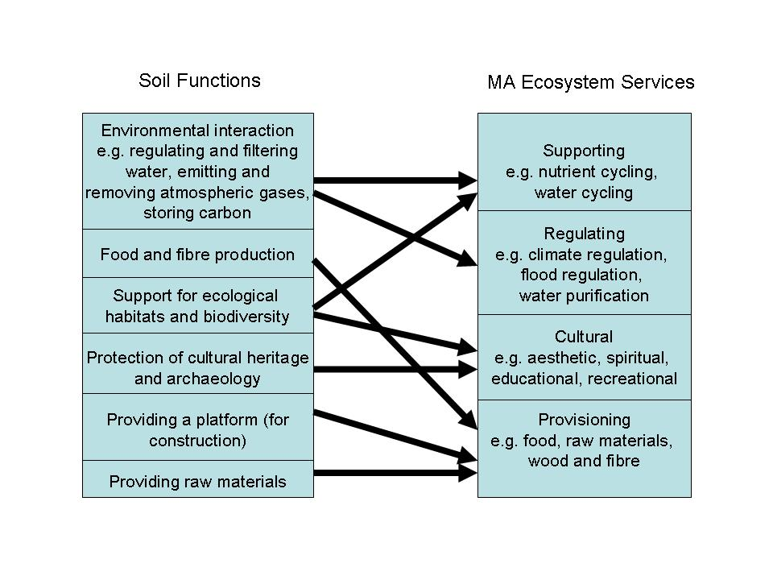
Soil Functions and the Millennium Ecosystem Assessment

Slide 7
The resultant threats to soils
Soil Erosion
Organic Matter decline
Compaction
Soil sealing
Soil contamination
Salinisation
landslides
Notes:
These threats were identified in the European Commissions Soil Thematic Strategy and form the basis of the focus in the proposed Soil Framework document.
Many of the threats are inter-related.

Slide 8
The impact of human activities on soil
Diffuse input of contaminants as particulates
Manures and fertilisers
Acids
Sewage sludge
Persistent substances
Pesticides & herbicides
Heavy metals
Accumulation/
Contamination
Gravel extraction
Gradual disappearance of farms
Soil erosion
Compaction
Release of toxic substances
Destruction of humus
Salinisation
Sealing
Acidification
Blocking of soil functions important to the ecology of the landscape
Destruction of soil
Gradual destruction of soils
Reduction in soil fertility
Changes in the structure of soils
Reduction in soil fertility
Contamination of soils and ground water with applied agrochemicals and atmospheric pollutants
Changes in soil composition
Adverse impacts on living organisms in the soil
Destruction of soil
EU-JRC-IES-Ispra/Italy

Slide 9
Soil Quality
The capacity of a specific kind of soil to function, within natural or managed ecosystem boundaries, to sustain plant and animal productivity, Maintain or enhance water quality, and support human health and habitation.
Karlen et al. 1997

Slide 10
Resilience
OED
‘The act of rebounding or springing back’
‘The power of assuming the original shape or position after pressure’

Slide 11
Soil Quality and Soil Resilience
They are interrelated but different
Quality refers to ecosystem functions and services
Resilience refers to the ability of a soil to restore itself. It is related to soil quality in terms of the recovery of soil functions.

Slide 12
Blum, W.E.H. 1994 Soil resilience – General approaches and definition.’ In Proceedings 15th World Congress of Soil Science, Acapulco, Mexico, July 10-16, 1994, pp. 233-237.

Slide 13
Types of Resilience
Ecological Resilience (Holling, 1973)
The capacity of a system to tolerate disturbance without changing to an alternative configuration – therefore it is important for maintaining the desired ecosystem functions and services.
Engineering Resilience (Pimm, 1984)
Defined as the time taken for a system to return to its predetermined , stable ‘state’ (a measure of the dynamics of a system in the region of stable equilibrium).

Slide 14
Resilience in Soil Systems
Resilience is important in soil science as land management practices and increasingly climatic variability impose frequent, sudden disturbances that perturb both the state (physico-chemical properties, microbial communities) and the functions (e.g. carbon cycling, nutrient cycling etc.) of a soil.
Therefore
It is increasingly important to seek to quantify the resilience of these soil functions in order to identify land management practices that minimise the negative effects of the disturbance.

Slide 15
How do we quantify resilience?
The degree of return to the original function
The time taken to return to the original function
The rate of return to the original function.

Slide 16
How do we define a resilient soil?
Characteristic | A more resilient soil response……
Degree of return | Returns to a stable level of function closer to a reference level (e.g. the initial level of function or level of a control sample)
Return time-The time taken to reach the new stable level of function | Reaches the stable level of function more quickly
Rate of return-The rate at which the response tends towards the stable level of function (i.e. related to the gradient of the return period) | Has a steeper gradient during return

Slide 17
Which to measure?
The degree of return is likely to be relevant in most contexts because it quantifies the long term ability of the system to continue to function following a disturbance.
The degree of return and return time could usefully be employed in assessing the effects of overgrazing or predation in terrestrial systems, the effect of extreme weather events on populations, and possibly changes in microbiomes due to stress.
The rate of return is likely to be of more interest in studies relating to critical slowing down (the idea that systems respond increasingly slowly as they approach an imminent tipping point).

Slide 18
Factors affecting soil resilience
Soil type (including soil biota) and vegetation
Climate regime
Land use
Disturbance regime
Temporal and spatial scales

Slide 19
General Soil Resilience Classes
Non-resilient - Soils are very seriously affected after continuous use.
Slightly resilient - Soils are seriously affected after continuous use.
Moderately resilient - Soils are moderately affected after continuous use.
Highly resilient - Soils are non- or slightly affected after continuous use.

Slide 20
Soil type and vegetation
Soil resilience is affected by both inherent and dynamic soil characteristics.
Most soil recovery mechanisms are biologically mediated, including cycling of nutrients, detoxification of nutrients and suppression of pathogenic organisms.
Vegetation recovery is also important to resilience.

Slide 21
Climate
A close relationship exists between soil resilience and climate.
Lal (1994) has suggested that the drier the climate the less resilient soil systems are after disturbances.

Slide 22
Land Use
Land use and management affects soil resilience. Management practices which maintain or enhance soil quality enhance soil resilience. The widely promoted management practice to increase soil organic matter levels will provide resilience against disturbances.

Slide 23
Scale
Soil resilience depends on the spatial scale of the disturbance.
If disturbance leaves un disturbed patches of vegetation the recovery may be more rapid and the resilience enhanced.
The time frame of recovery is also important in considering resilience. Some changes may take a single season,others may occur through a lifetime.

Slide 24
Soil function and recovery processes
Soil Function | Recovery Process
Nutrient Cycling | Biological activity, biological diversity, plant growth
Partitioning of Water | Soil fauna activity (earthworms, termites, etc.) shrink-sell cycles, freeze-thaw cycles, plant growth
Productivity | C sequestration, aggregation processes, nutrient cycling, biological diversity
Water Storage | C sequestration, aggregation processes, biological activity
Decomposition | Biological activity
Absorbing and detoxifying pollutants | Biological activity, C sequestration, biological diversity, mineral weathering, clay formation
Nutrient supply capacity | Biological activity, mineral weathering, nutrient cycling

Slide 25
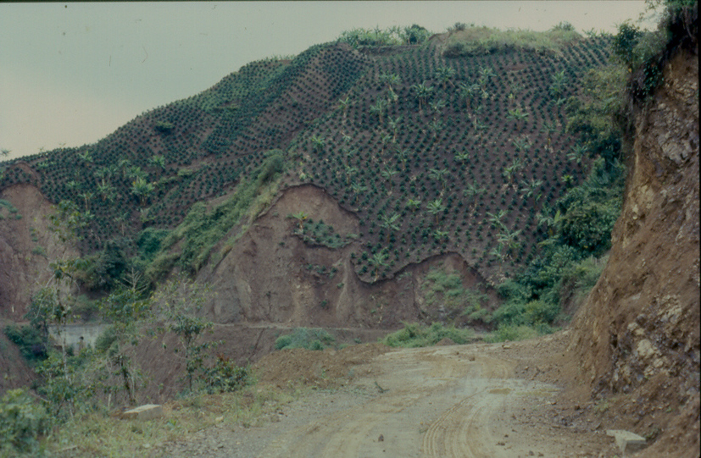

Slide 26
Conclusions
If we are to move forward with Sustainable Soil Management and Strategies for Soil Protection we must consider concepts of soil resilience.
We must identify practices to define a soil’s resilience to changing environmental conditions and management practices.
Soil management strategies must be linked to soil resilience.

Slide 27
Thank you!

